Slide 1



Multiple diploma student exchange programme
International Finance Programme
IFP: Italy-France-Poland
Master degree
in Economics
Master degree
in Finance,
specialty Law and Finance
Masters degree in
Markets and
Financial Institutions

Slide 2
The Exchange Programme
The Exchange Programme in:
International Finance and Economy
aims to provide advanced competencies in Economics, Finance, Management, Law that will allow graduates to work in a wide range of international contexts.
Career opportunities
Banks & Financial Intermediaries
Asset Management Companies
Insurance Companies
Consulting & Auditing Companies
Export Oriented & International Companies
International Trade Agencies
Central Banks
International Organizations

Slide 3
General Information
2 year study program (4 terms)
English taught Classes: (theoretical lectures, discussion of case studies, group work)
Integration of theoretical and practical competences through seminars held by professionals.
 | First term | Second term | Third term | Fourth term
 | Home University | University Macerata | University Angers | University Torun
Students from University Macerata | × | × | × | ×
Students from University Angers | × | × | × | ×
Students from University Torun | × | × | × | ×

Slide 4
Course of Study Program
Second Term (University of Macerata – Italy) | ECTS
Financial risk management | 6
Advanced international trade | 6
Mathematical methods for economics and finance | 6
International marketing | 9
Financial crisis | 3
Total ECTS | 30
Third Term (University of Angers – France) | ECTS
Corporate Finance | 9
Financial Regulation | 11
Law & Economics | 10
Total ECTS | 30
Third Term (University of Torun – Poland) | ECTS
Master's Diploma Seminar / Master Thesis | 10
Academic Writing and Research Seminars | 8
Financial Analysis and Managerial Accounting | 6
Portfolio Theory | 6
Total ECTS | 30

Slide 5
Admission requirements
A maximum of ten students from each institution will be selected to participate the program.
Students are required to be compliant with the eligibility criteria in effect in each country to enroll to a master’s degree.
Italian and University of Macerata regulations require that students must hold a 3-years Bachelor’s degree in economic, finance or management disciplines.
English language: English language will be a preferential condition for the selection.

Slide 6
Practical information
The students admitted to the exchange program will only pay registration fees of their home institutions and they will be admitted in the partner universities in force of the mutual agreement.
The students selected joining the mobility programme are required to collect 30 credits in each semester. The rules to take and repeat exams are those in effect in the university which hosts the group of students.
During the abroad-terms students may receive financial support by applying to the Erasmus+ programme.

Slide 7
Partner Universities

Slide 8
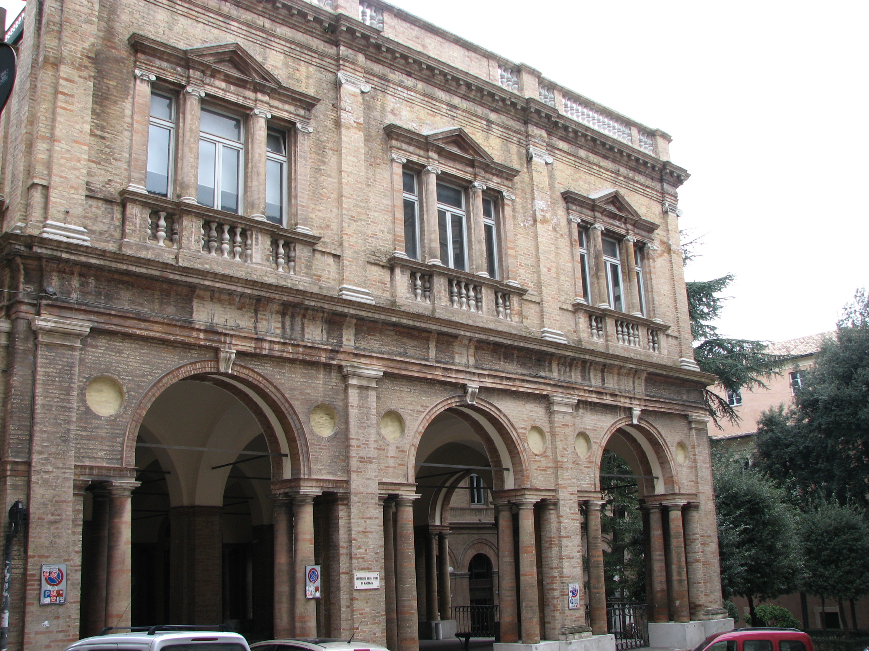
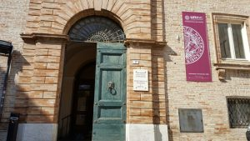
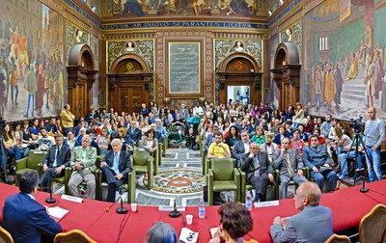
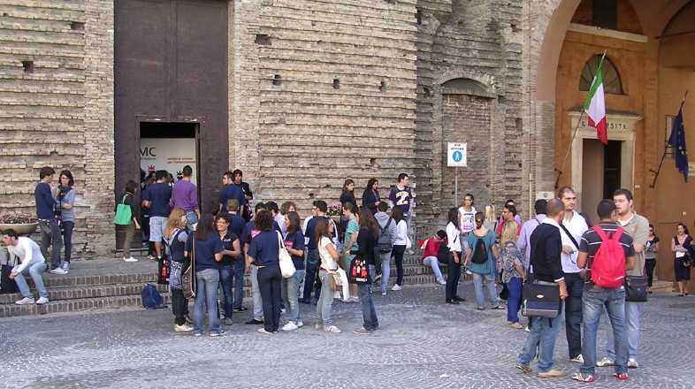
The University of Macerata is one of the three oldest public universities in Italy and among the oldest in Europe, founded 1290
https://www.youtube.com/unimcwebtv

Slide 9

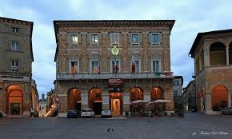

Strong university-industry linkages in one of the largest fashion & design district; very export oriented with many job opportunities
Typical small ancient Italian city; student focused; environment friendly; everything at a walking distance in the historic centre;
excellent university sport facilities; famous opera house & theatre.
Cost of life really affordable (compared to other Italian cities)
International Environment

Slide 10
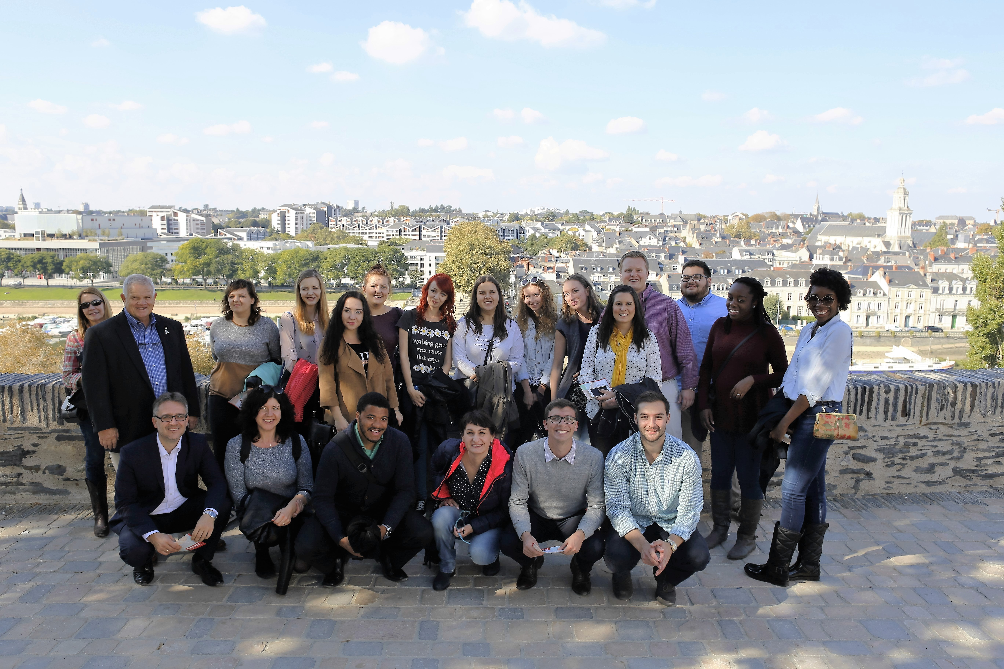
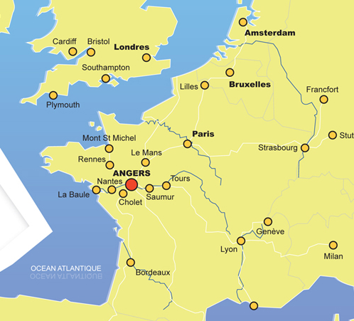
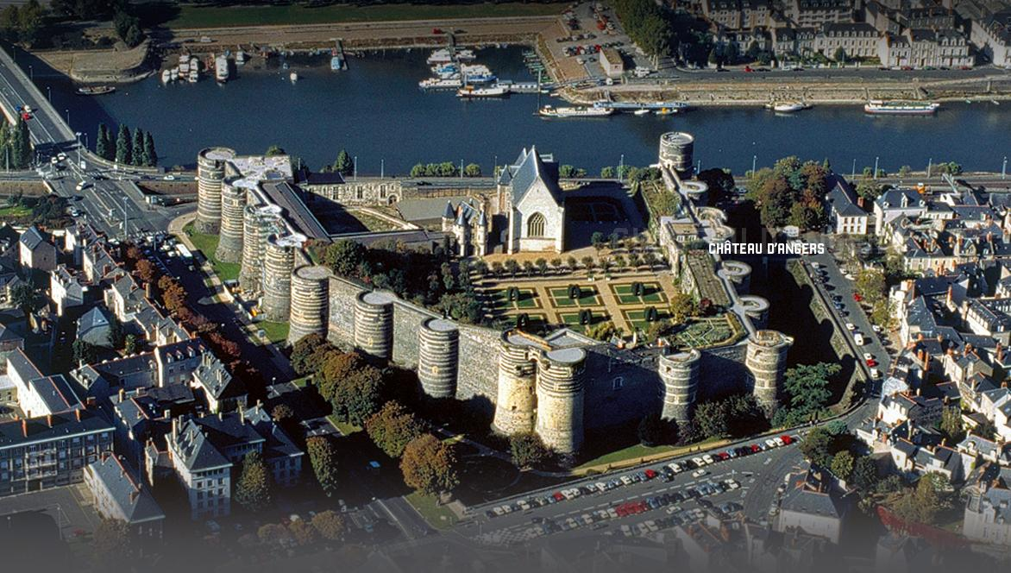

Slide 11
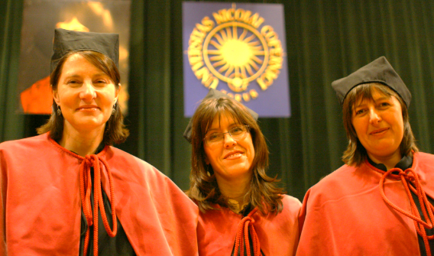
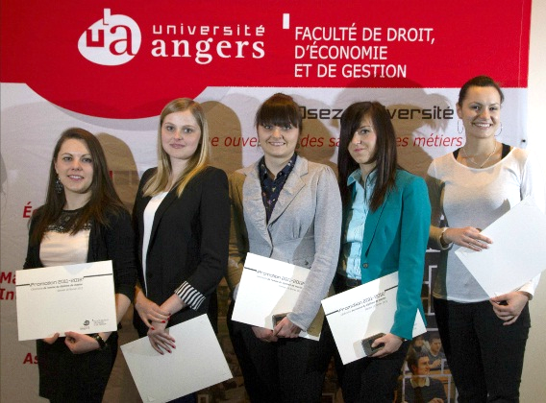
One of the best Universities in France
Strategic partner of Nicolaus Copernicus University since 1980’

Slide 12

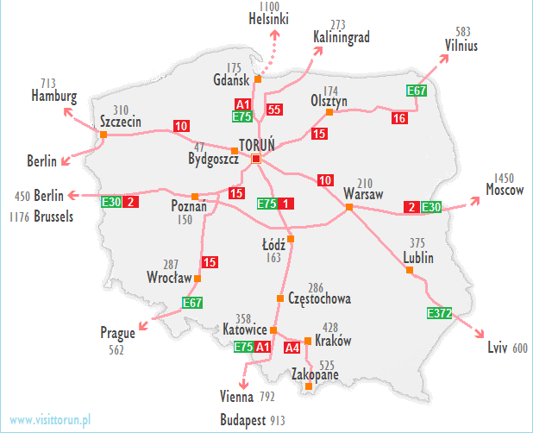
Location in the centre of Poland
Nicolaus Copernicus University
Faculty of Economic Sciences and Management

Slide 13

AACSB Acreditation
the Faculty of Economic Sciences and Management as the first and the only state university in Poland received this very prestigious business AACSB accreditation.
Currently, only 5% of all business schools in the world hold an AACSB accreditation including: Harvard University, London Business School.
Receiving AACSB Accreditation means that a given institution is able to achieve a rigorous set of quality standards defined by AACSB International. The AACSB Accreditation Standards challenge post-secondary educators to pursue excellence and continuous improvement throughout their business programs.

Slide 14

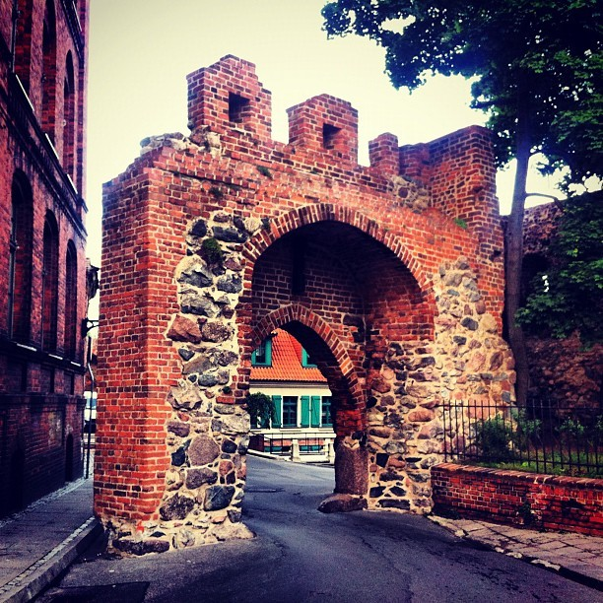

Nice city, full of attractions

Slide 15
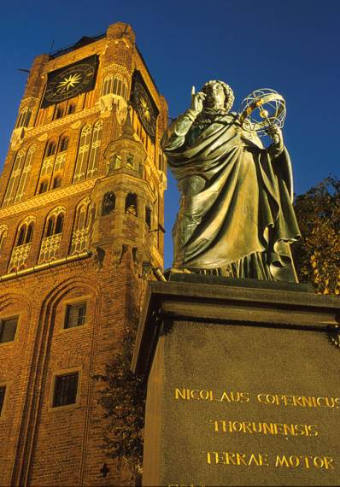




Slide 16
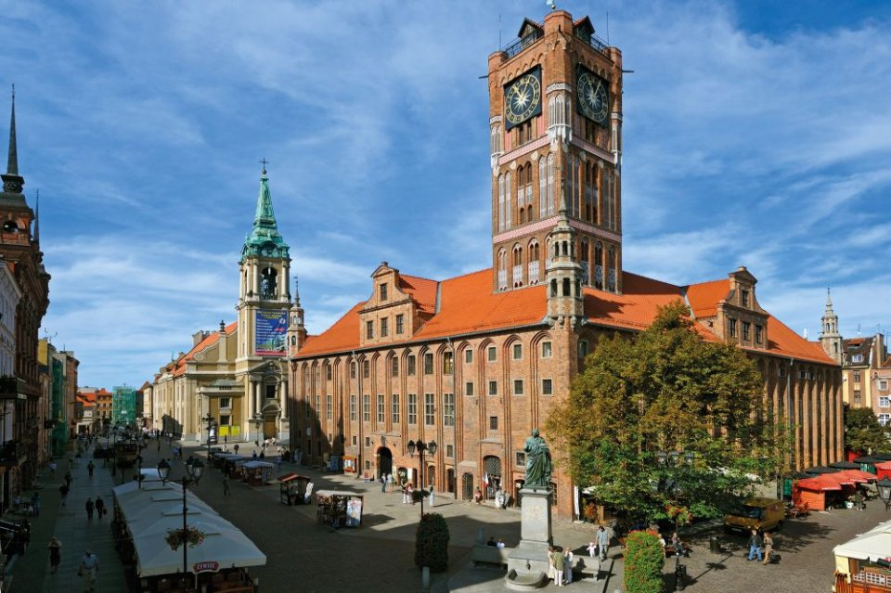

Slide 17


Slide 18


Slide 19


Slide 20
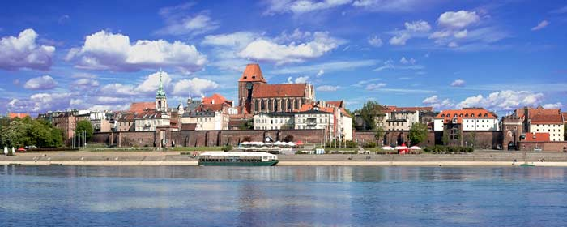


Slide 21


Slide 22
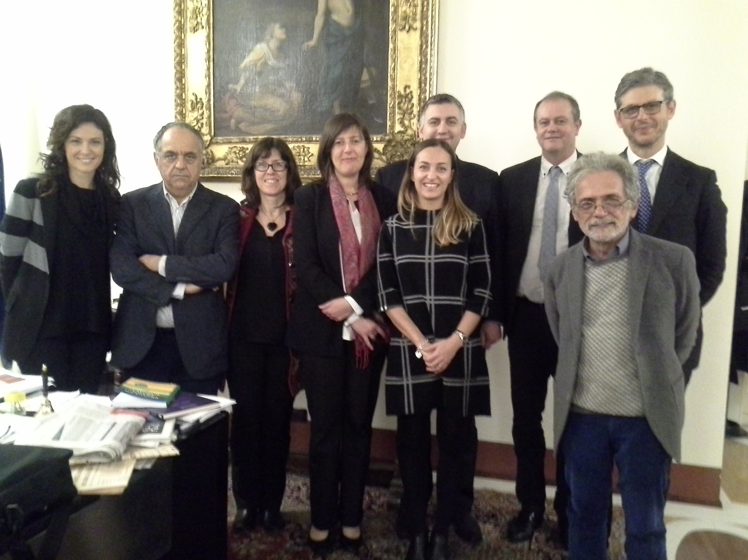
Triple degree:
NCU – Universite d’Angers – University of Macerata (Italy)
Master in Economics & Finance:
International
Finance
Programme

Slide 23
Information Meeting about Triple Diploma
MACERATA – ANGERS - TORUŃ
Nicoletta Marinelli
Office hours: Monday 11-13
Email: nicoletta.marinelli@unimc.it

